Slide 1



Scope of Disclosure | TSIP Team
Confidential period | Indefinite
Head of information owner section | Head of Training Division
Handling restriction | “No Copying” , “No Printing” “No transferring”, “No re-disclosure” “No circulation” , “Do not duplicate”
Use Cases

Slide 2


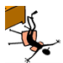
UML 2.5 discussions have been known to cause or induce sleep among participants.
Necessary precautions to prevent injuries due to participants falling off chairs ,resulting from UML-induced stupor is highly advised ☺
Please do not fall off the chair !

Slide 3
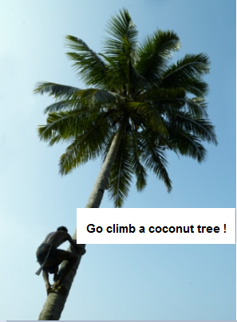
Let’s model some UseCases !

Slide 4
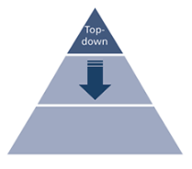
Use Cases : Cornerstone for top-down design

Slide 5
UseCases* are a means to capture the requirements of systems
what systems are supposed to do
Subject represents a system under consideration to which the UseCase applies
Users and any other systems that may interact with a subject are represented as Actors
* Instances of Usecases are modelled as Interactions.

Slide 6
Actors
An Actor models a type of role played by an entity that interacts with the subjects of its associated UseCases (e.g., by exchanging signals and data).
An Actor may represent roles played by human users, external hardware, or other systems
Thus, a single physical instance may play the role of several different Actors and, conversely, a given Actor may be played by multiple different instances.
An UseCase may have associated Actors, which describe how an instance of the Classifier realizing the UseCase and a user playing one of the roles of the Actor interact.

Slide 7
Subjects
A subject of a UseCase could be a system or any other element that may have behavior, such as a Component or Class

Slide 8
UseCases
An UseCase is a specification of behavior *
An UseCase behavior could result in changes to state and communications with environment
An UseCase is complete only if the functionality is completed
=> no further inputs is expected and use case can be initiated again
=> error state
* Behavior could be represented by the following :
Activities
State Machine changes
Interactions

Slide 9
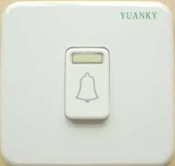
Ex #1 : A Calling Bell

Slide 10
UseCases
An UseCase specifies a set of behaviors performed by the subject, which yields an observable result
An UseCase Is a kind of BehavioredClassifier
Represents a declaration of a set of offered Behaviors
An UseCase does not describe the internal structure of the subject
An UseCase specifies a unit of useful functionality that the subject provides to its user

Slide 11
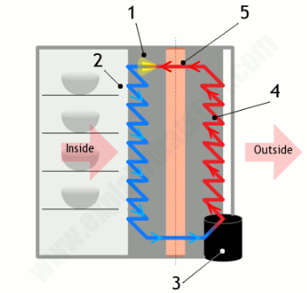
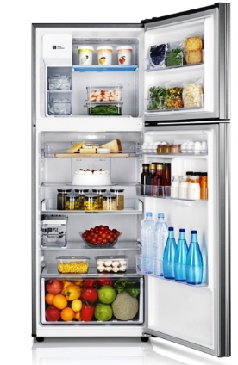
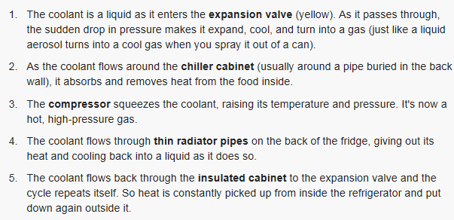
Ex #2 : A Refrigerator

Slide 12
UseCases
An UseCase can be used both for specification of the (external) requirements on a subject and for the specification of the functionality offered by a subject.
An UseCase may also state the requirements the specified subject poses on its environment by defining how the Actors should interact with the subject so that it will be able to perform its services

Slide 13

Ex #3 : A Watch

Slide 14
UseCases
An UseCase may apply to any number of subjects
An UseCase can include possible variations of its basic behavior, including exceptional behavior and error handling

Slide 15
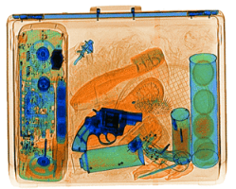
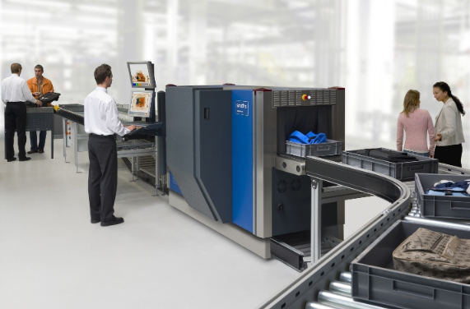
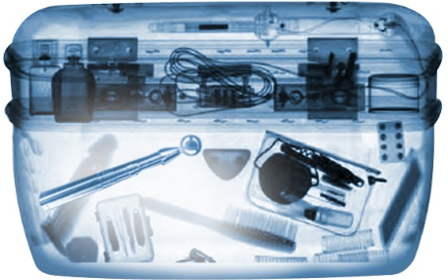
Ex #4 : A Baggage Scanner
Reject
Accept

Slide 16
UseCases
An Actor does not necessarily represent a specific physical entity but instead a particular role of some entity that is relevant to the specification of its associated UseCases.

Slide 17

Ex #5 : Access Card System

Slide 18
UseCases
When an Actor has an association to a UseCase with a multiplicity that is greater than one at the UseCase end, it means that a given Actor can be involved in multiple UseCases of that type.
When a UseCase has an association to an Actor with a multiplicity that is greater than one at the Actor end, it means that more than one Actor instance is involved in the UseCase
An Actor may initiate multiple UseCases in parallel (concurrently) or at different points in time.
Simultaneous (concurrent) action by two separate Actors or it might require complementary and successive actions by the Actors (e.g., one Actor starting something and the other one stopping it) ; manner in which multiple Actors participate in the UseCase depends on the specific situation on hand and is not defined in this specification

Slide 19
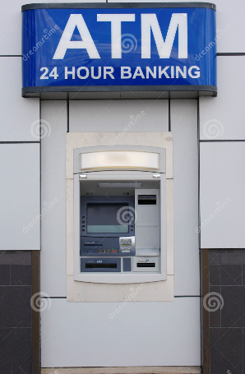
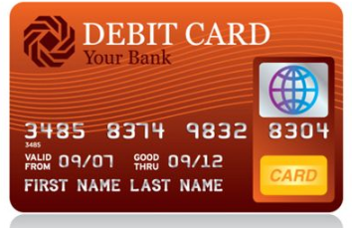
Ex #6 : An ATM Machine

Slide 20
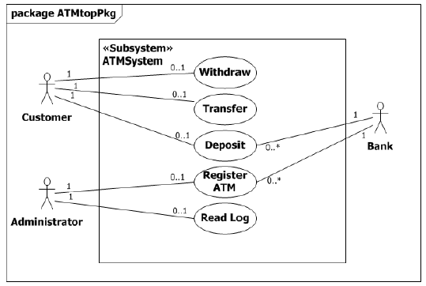
UseCase Multiplicity
Multiplicity
Customer or Administrator may or may not participate in any of their associated UseCases (hence the 0..1 multiplicity)
Every UseCase in the example must have an Actor to initiate it (hence the 1 multiplicity)
Deposit and Register ATM UseCases require participation by the Bank (hence the 1 multiplicity)
Bank can participate with many Deposit and Register ATM UseCases at the same time or may not have any deposits or ATM registrations at all (hence the 0..* multiplicity)

Slide 21
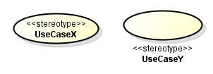
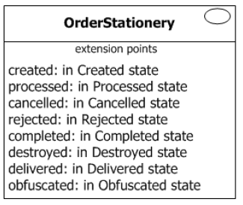
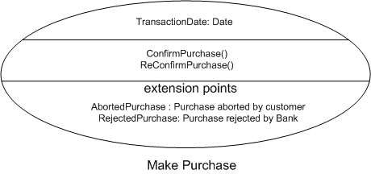
Notations : Use Case

Slide 22

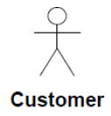
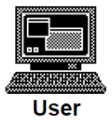

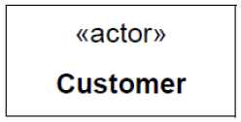
Notations : Actors
Bank

Slide 23
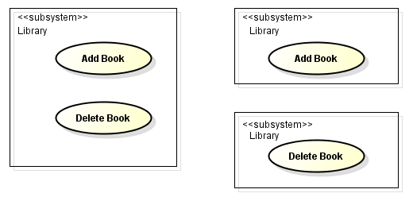
Notations : Subjects

Slide 24
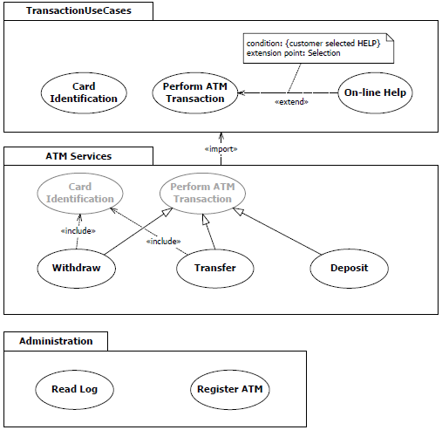
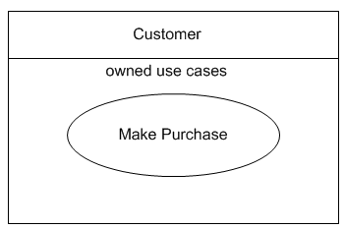
UseCases ownership : Packages & Classifiers
An usecase may be owned by a Package or by a Classifier
* Owning Classifier may or may not represent the subject
Classifier Ownership
Package Ownership

Slide 25
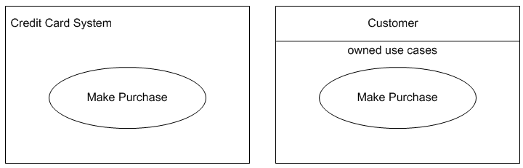
Subjects : Optional Ownership
Subject rectangle does not imply that the subject classifier owns the contained UseCases, but merely that the UseCases apply to that classifier. In particular, there is scope for confusion between a UseCase appearing visually contained in a boundary rectangle representing a Classifier that is its subject, and appearing visually contained in a compartment of a Classifier that is its owner.
The nesting (owning) of a UseCase by a Classifier may optionally be represented by nesting the UseCase ellipse inside the Classifier rectangle in a separate compartment

Slide 26
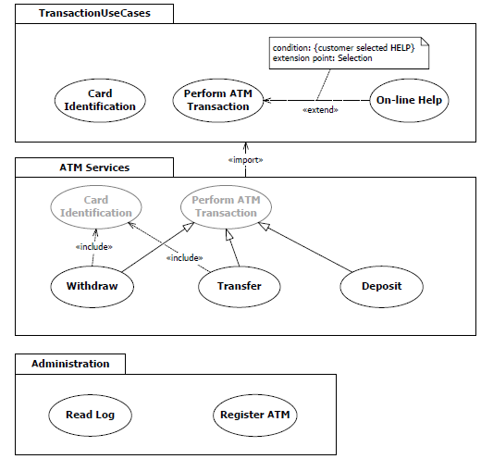
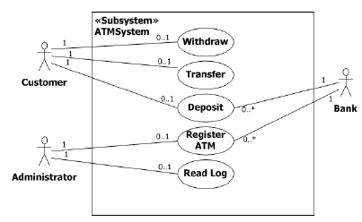
Subjects : Optional Ownership
UseCases need not be owned by their subject

Slide 27
Extend Relationship
An Extend is a relationship from an extending UseCase (the extension) to an extended UseCase (the extendedCase) that specifies how and when the behavior defined in the extending UseCase can be inserted into the behavior defined in the extended UseCase
The extension takes place at one or more specific extension points defined in the extended UseCase
Used when there is some additional behavior that should be added, possibly conditionally, to the behavior defined in one or more UseCases
Is defined independently of the extending UseCase and is meaningful independently of the extending UseCase
The extending UseCase typically defines behavior that may not necessarily be meaningful by itself.
The extending UseCase defines a set of modular behavior increments that augment an execution of the extended UseCase under specific conditions
Same extending UseCase can extend more than one UseCase.
An extending UseCase may itself be extended.

Slide 28
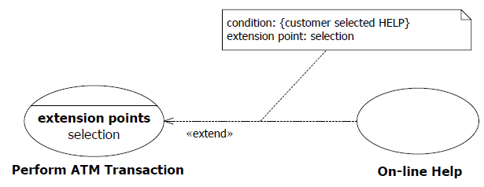
Extend Relationship
An Extend relationship between UseCases is shown by a dashed arrow with an open arrowhead pointing from the extending UseCase towards the extended UseCase. The arrow is labeled with the keyword «extend». The condition of the Extend as well as references to the ExtensionPoints are optionally shown in a note symbol

Slide 29
Extend Relationship
Extend is a kind of DirectedRelationship, such that the source is the extending UseCase and the target is the extended UseCase
It is also a kind of NamedElement so that it can have a name in the context of its owning UseCase.
The Extend relationship itself is owned by the extension.
An ExtensionPoint identifies a point in the behavior of a UseCase where that behavior can be extended by an Extend relationship. Each ExtensionPoint has a unique name within a UseCase
Thus, an extending UseCase typically consists of one or more behavior fragment descriptions that are to be inserted into the appropriate spots of the extended UseCase. An extensionLocation, therefore, is a specification of all the various ExtensionPoints in a UseCase where supplementary behavioral increments can be merged.

Slide 30
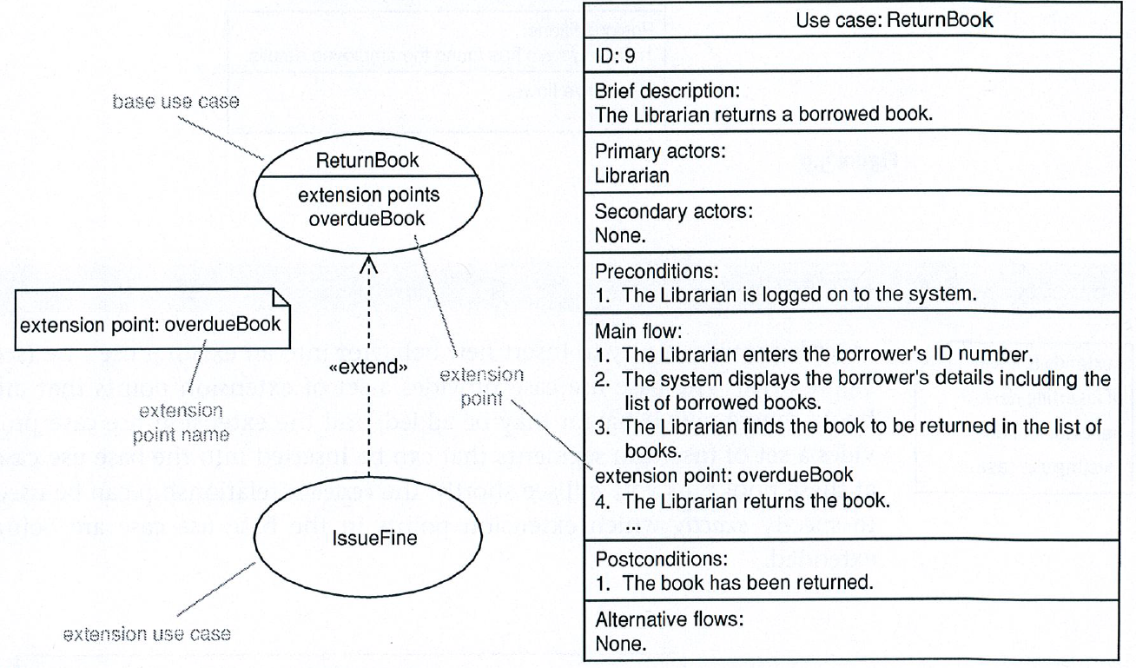
Extension Points

Slide 31
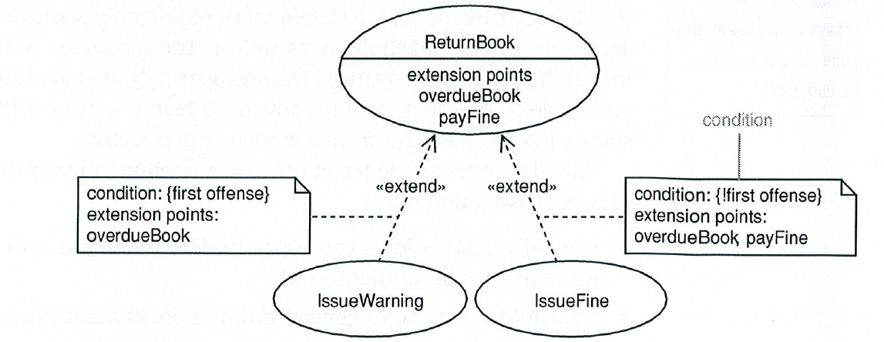
Conditional Extension

Slide 32
Include Relationship
Include is a DirectedRelationship between two UseCases, indicating that the behavior of the included UseCase (the addition) is inserted into the behavior of the including UseCase (the includingCase)
Kind of NamedElement so that it can have a name in the context of its owning UseCase (the includingCase)
Must be available for the behavior of the including UseCase to be completely described
Used when there are common parts of the behavior of two or more UseCases
Common part is then extracted to a separate UseCase, to be included by all the base UseCases having this part in common
What is left in a base UseCase is usually not complete in itself but dependent on the included parts to be meaningful
reflected in the direction of the relationship, indicating that the base UseCase depends on the addition but not vice versa.
All of the behavior of the included UseCase is executed at a single location in the included UseCase before execution of the including UseCase is resumed

Slide 33
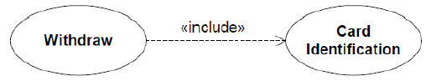
Include Relationship
An Include relationship between UseCases is shown by a dashed arrow with an open arrowhead pointing from the base UseCase to the included UseCase. The arrow is labeled with the keyword «include»

Slide 34
Include Relationship - Hierarchical composition
The Include relationship allows hierarchical composition of UseCases as well as reuse of UseCases

Slide 35
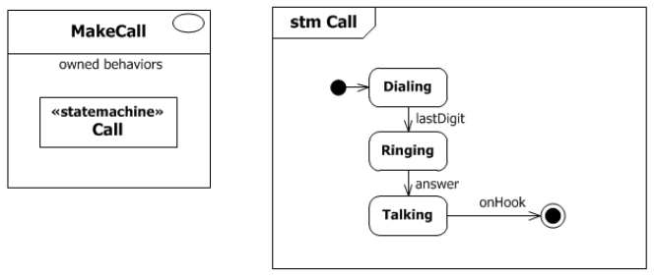
Association of UseCase with State Machine
Ex: UseCase which has a StateMachine as one of its ownedBehaviors

Slide 36
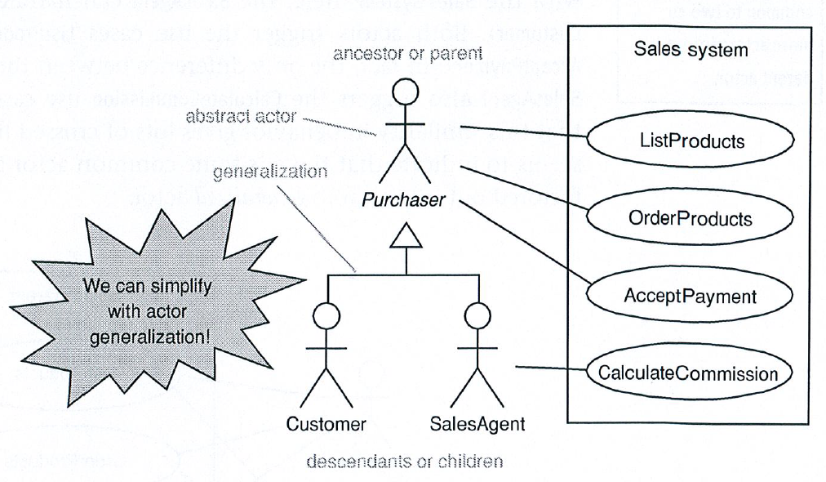
Actor Generalization

Slide 37
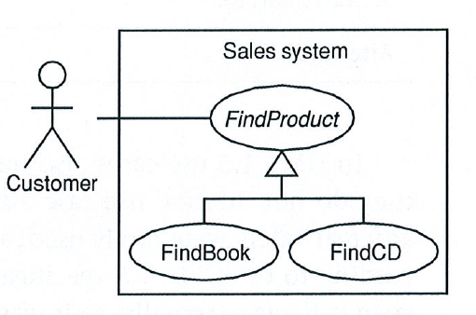
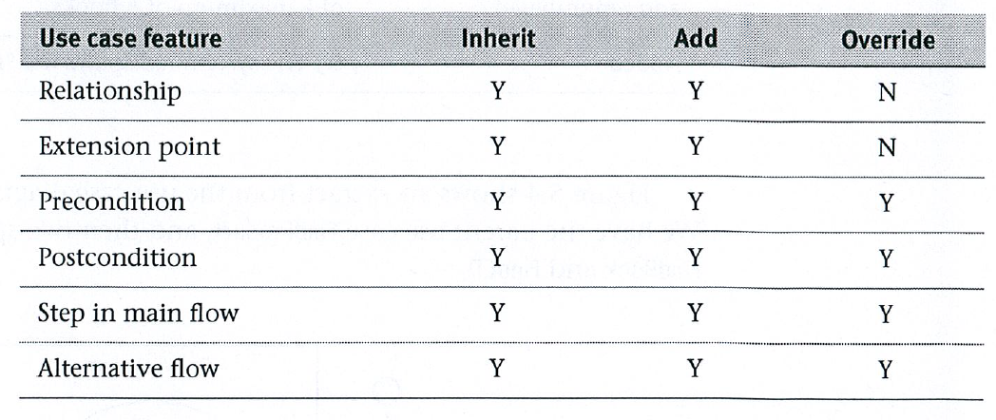
Use Case Generalization

Slide 38
Reference:
Chapter 18 of the UML 2.5 Specification
Writing Effective Use Cases : Alistair Cockburn

Slide 39
Guidelines for Usecases
[Not included in OCUP Exam syllabus]

Slide 40
Writing Effective Use Cases
UseCase as a ‘Contract’
UseCase Extraction : Actor-to-UseCase, Usecase-to-Actor
Hub & Spoke Model : All Requirements under Usecase umbrella
Avoid Functional Decomposition
Sequences V/s UseCases [Intent Focus] :Focus on intent and not actors’ movement / interaction steps
Goal Hierarchy : Shifting User Goal Levels
Use Case ‘Folding’ / UI overload
Use Case Design Strategy (Breadth-First)
Use Case Refinement : Refactoring usecases
Complex Hierarchy : Avoid deep include/extend hierarchy
Use Case Specification : Template
Traceability of Requirements : Table
Use-case Completeness : Criteria for completion

Slide 41
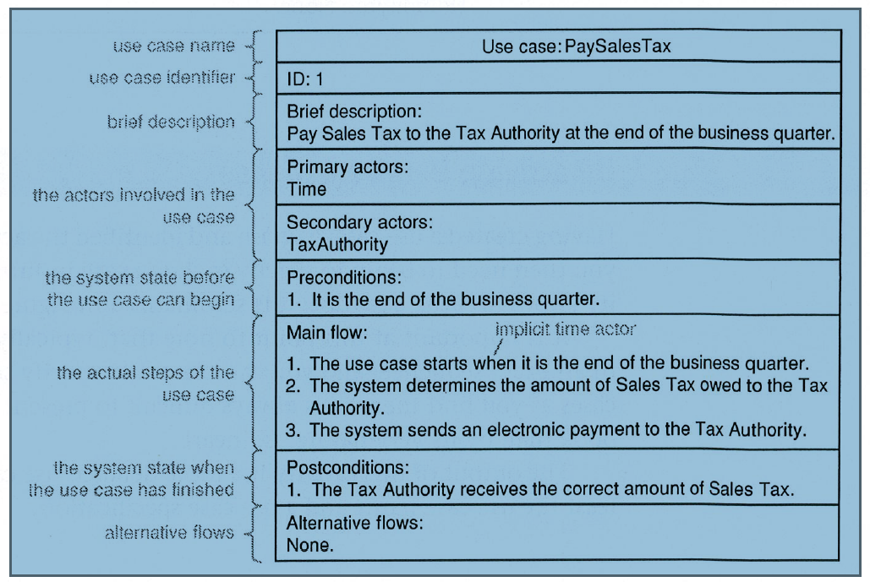
Use Case Specification

Slide 42
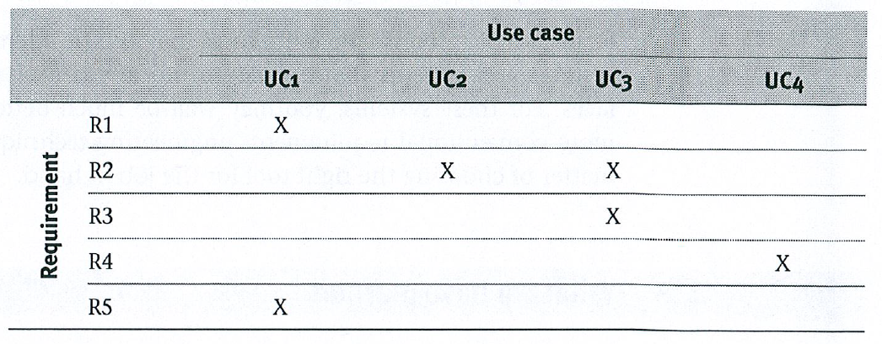
Traceability of Requirements

Slide 43
Annexure

Slide 44
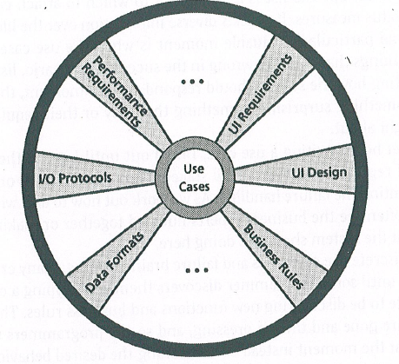
Hub and Spoke Model of Requirements

Slide 45
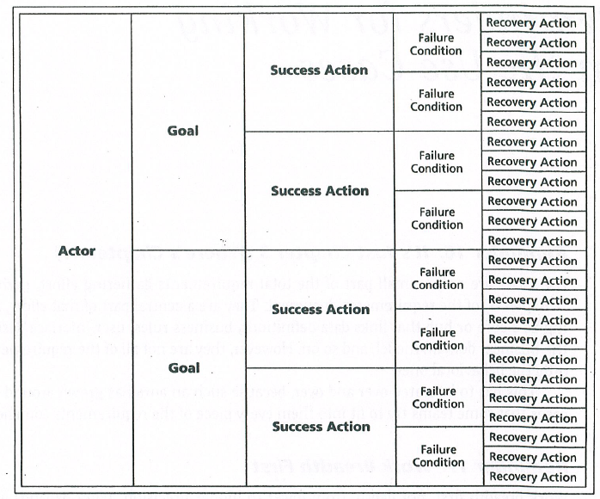
Breadth First Design

Slide 46
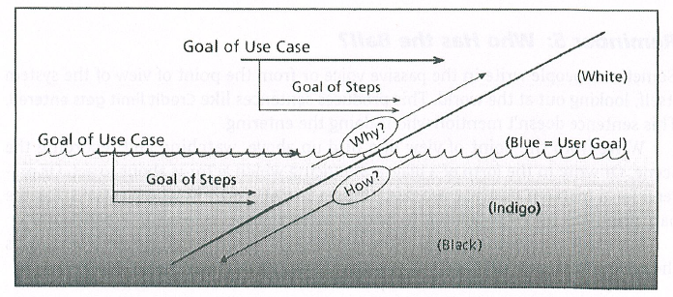
‘Folding’ Usecases

Slide 47
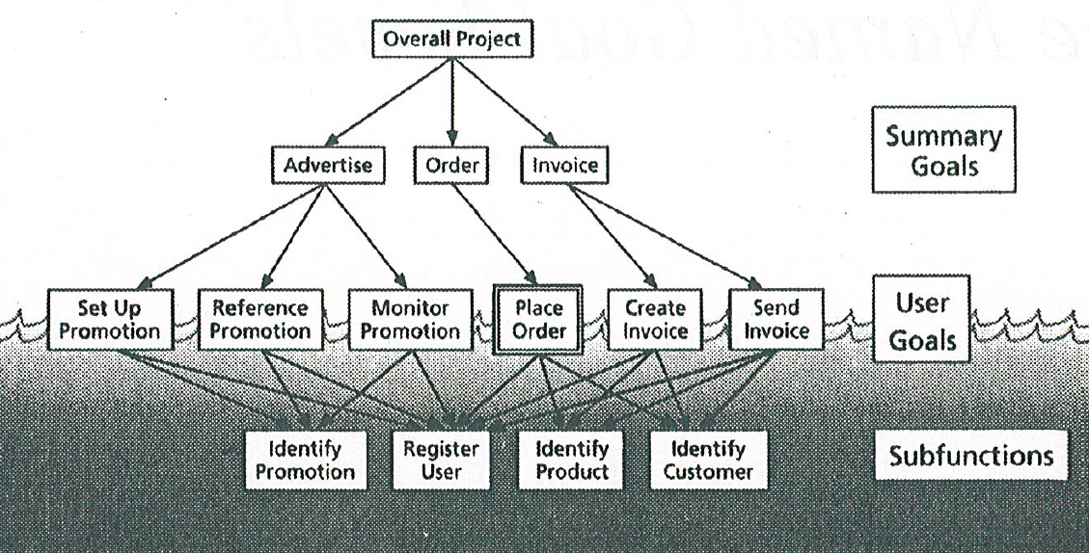
Summary Goals, User Goals & SubFunctions

Slide 48
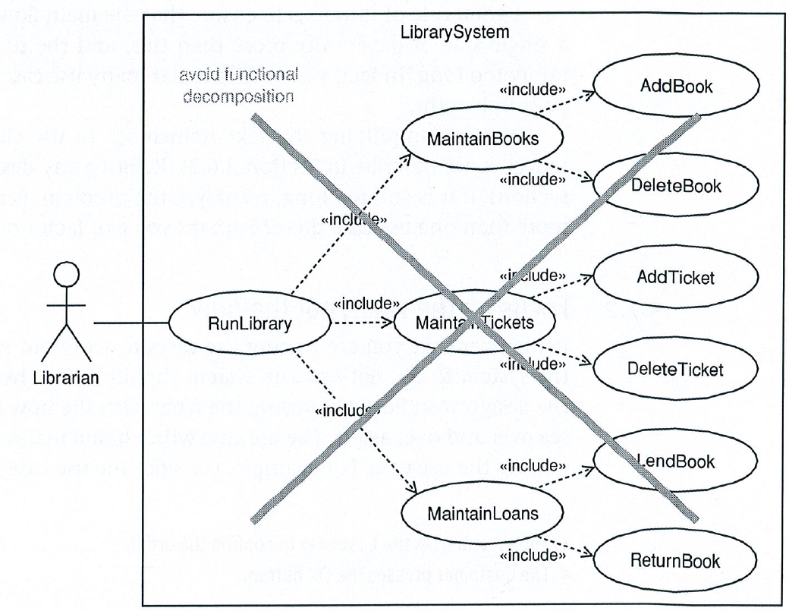
Avoid Functional Decomposition

Slide 49
Reference:
Writing Effective Use Cases : Alistair Cockburn

